Slide 1
802.15.4 Project
The Northernites
Sam Weismuller, SangRyul “Eric” Pae, Jay Cordaro
MAS 2023 Students UC San Diego

Slide 2
802.15.4 Project RF Front End components test results

Slide 3
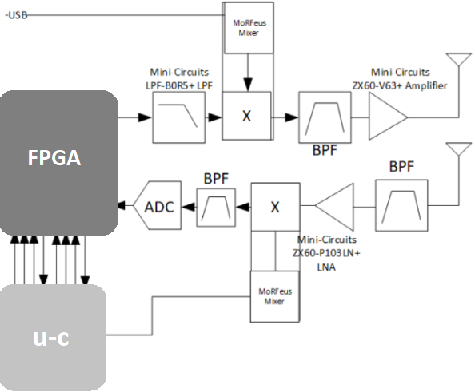
Block Diagram

Slide 4
RX

Slide 5
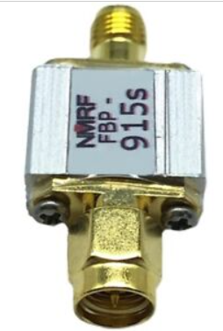
Rx RF BPF-1
FBP-915s
Impedance:50 ohms
Center frequency:915MHz
Passband:902～928MHz
Band Insertion Loss:<2.5 dB
Out-of-band isolation: > 40 dB @ 815 MHz and 1015 MHz
Maximum load power:300 mW (25 dBm)
Interface:SMA-M, SMA-F

Slide 6
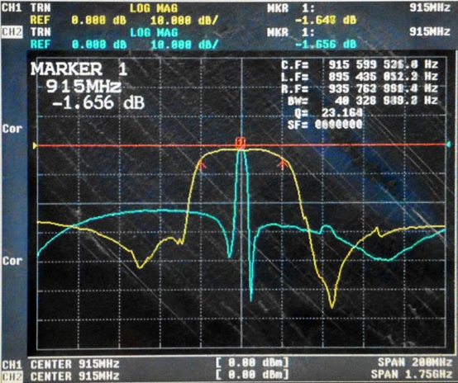
Rx RF BPF
FBP-915s
Impedance:50 ohms
Center frequency:915MHz
Passband:902～928MHz
Band Insertion Loss:1.7 dB
Out-of-band isolation: > 40 dB @ 815 MHz and 1015 MHz
Maximum load power:300 mW (25 dBm)
Interface:SMA-M, SMA-F

Slide 7
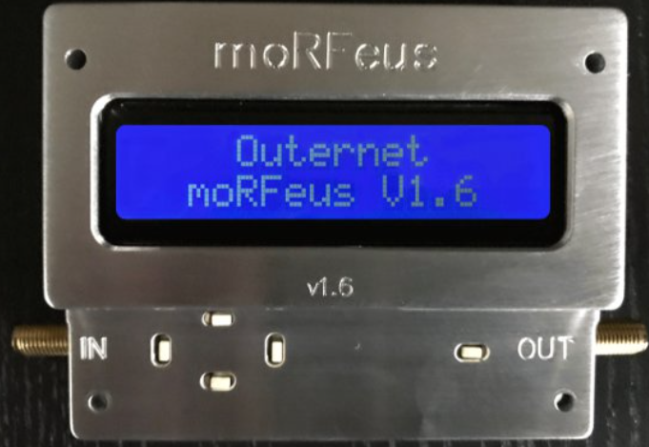
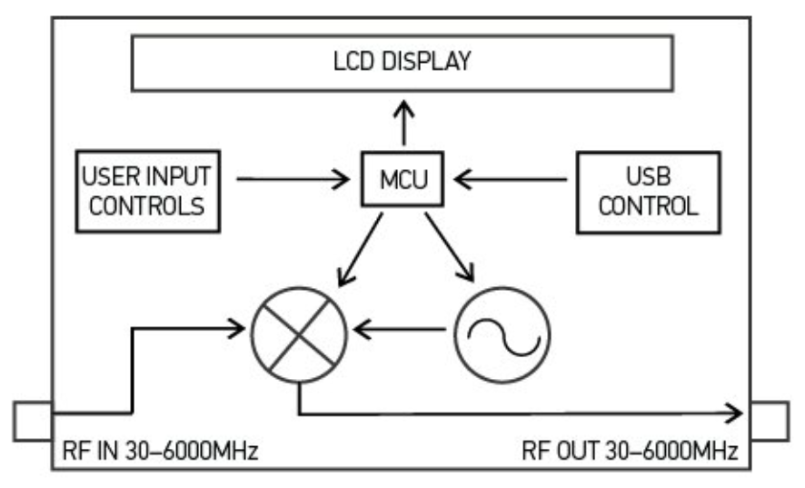
Mixer + PLL + TCXO
moRFeus
RF input frequency: 30 MHz – 6 GHz
RF output frequency: 30 MHz – 6 GHz
LO frequency: 85 MHz – 5400 MHz
Fractional-N synthesizer
LO step size: 1.5 – 3 Hz*
Up/Down conversion both are OK
(*alternative option for 2nd unit: )
( Mini-Circuits ZAD-2 mixer + SigGen with ref sync)
(* UCSD SigGen )

Slide 8
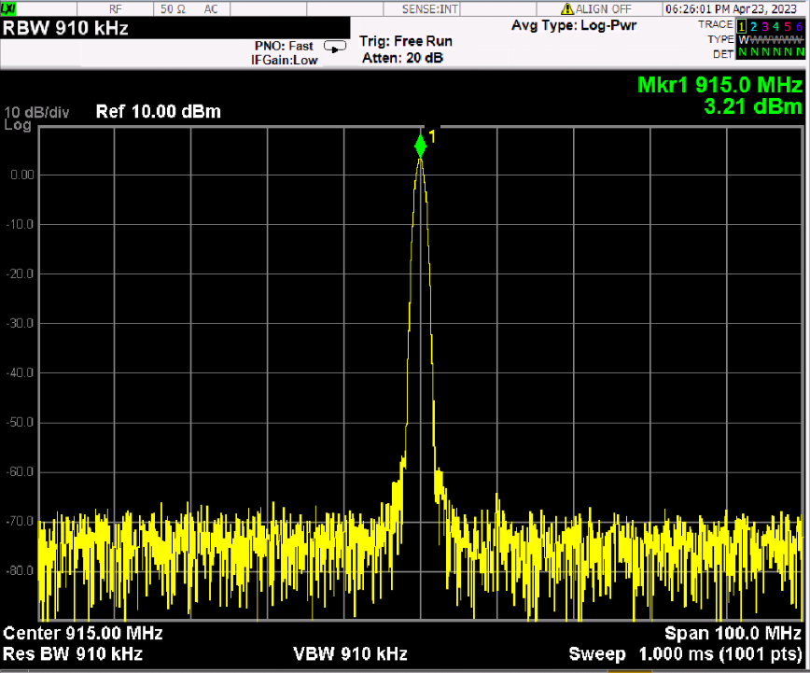
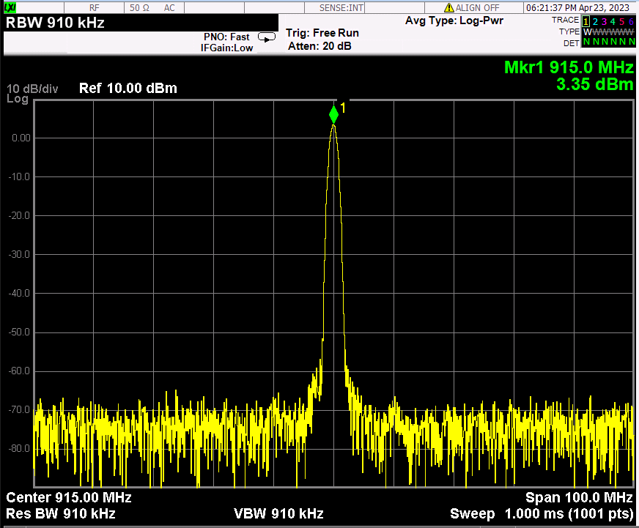
Generator mode
<moRFeus A current7>
<moRFeus B current7>

Slide 9
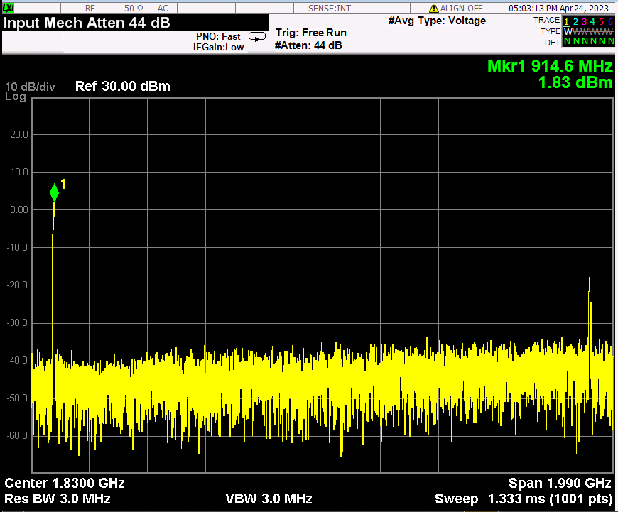
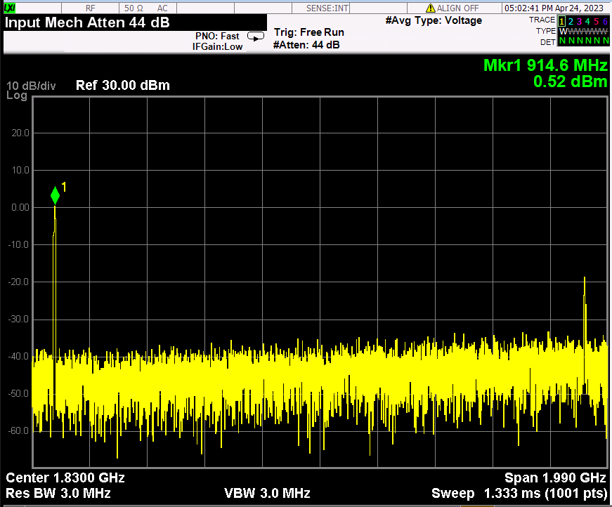
Generator mode
<moRFeus B current6>
<moRFeus B current5>

Slide 10
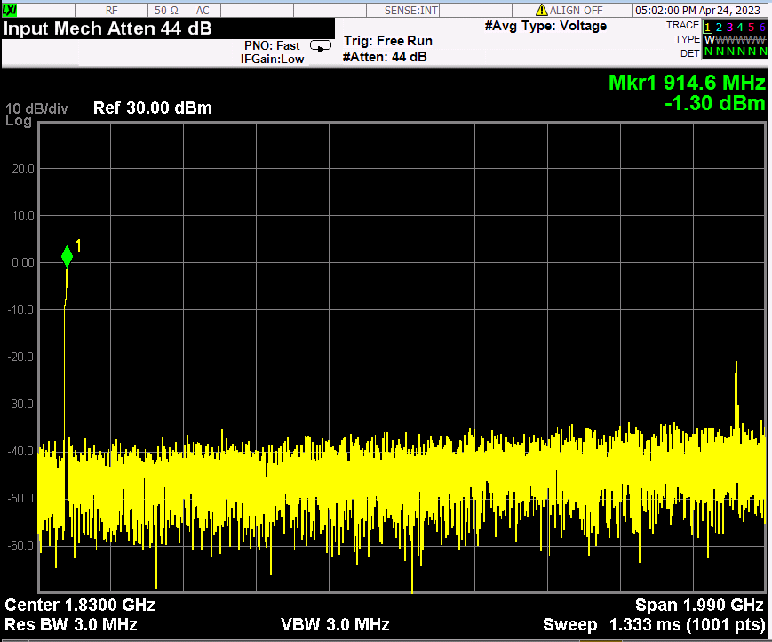
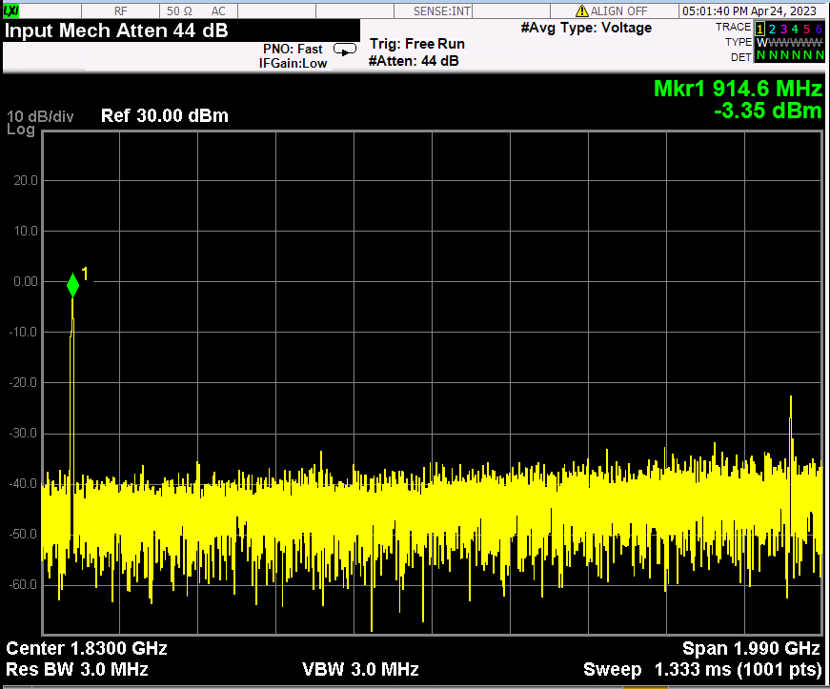
Generator mode
<moRFeus B current4>
<moRFeus B current3>

Slide 11
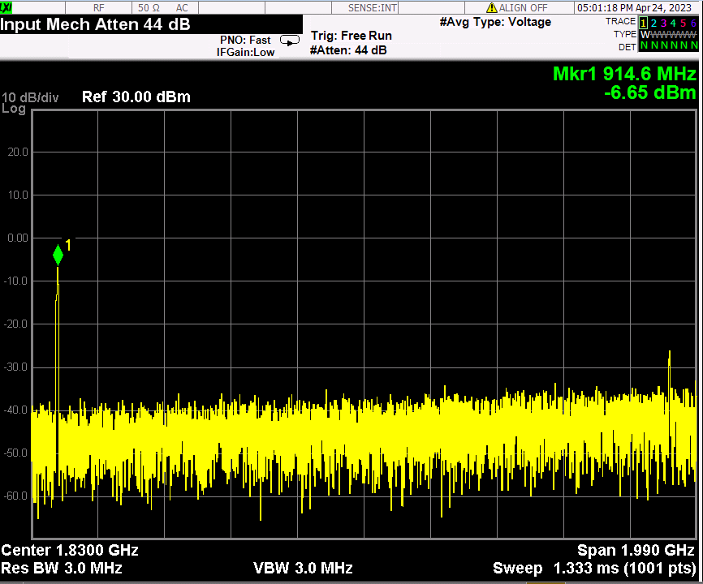
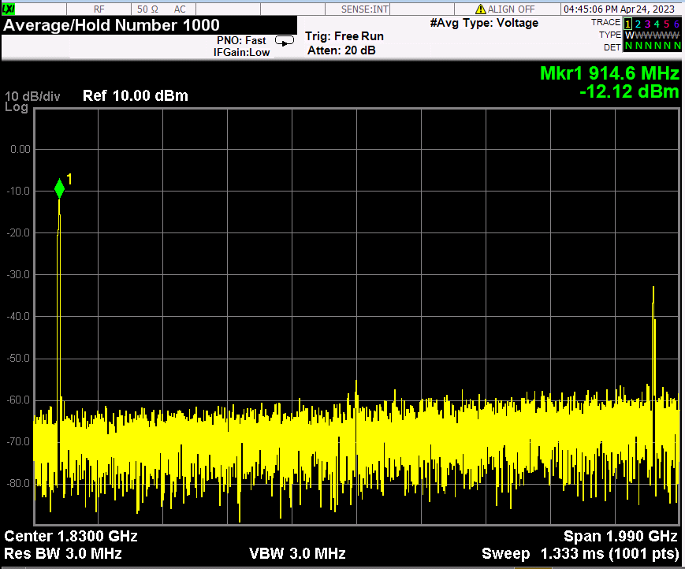
Generator mode
<moRFeus B current2>
<moRFeus B current1>

Slide 12
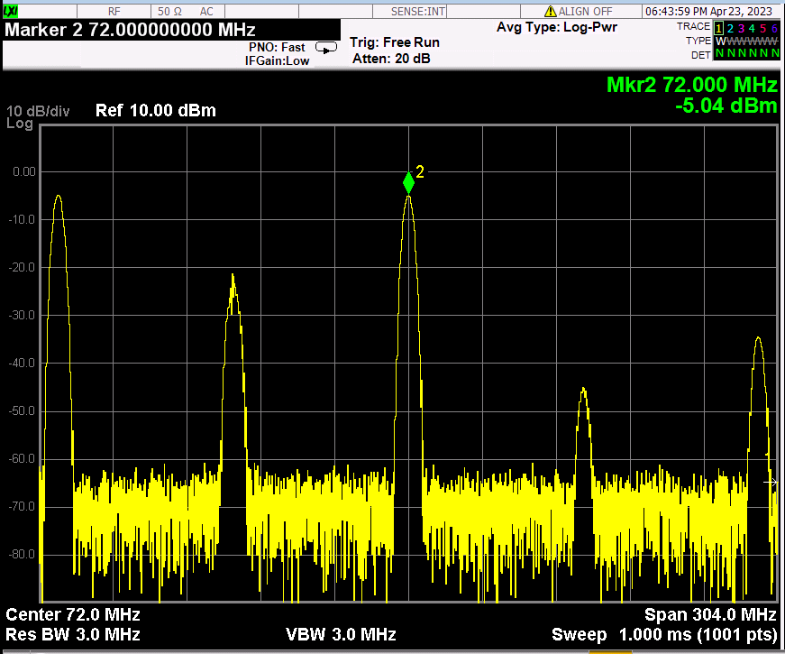
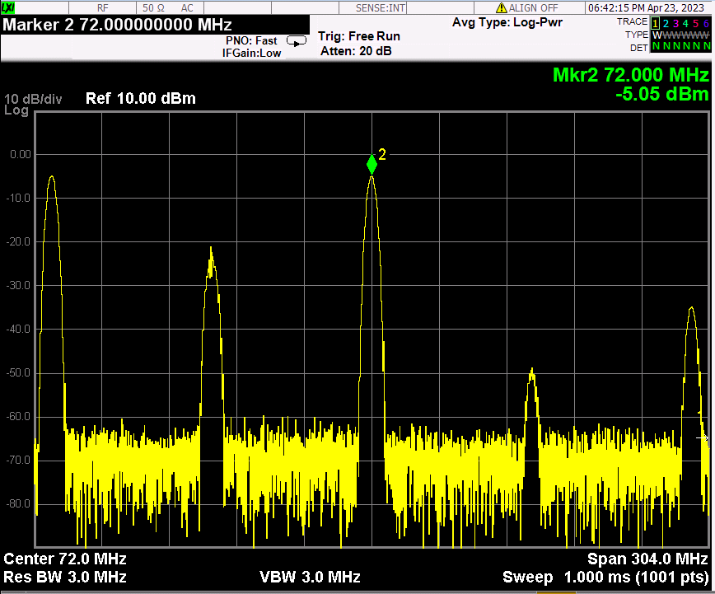
Mixer mode
morFeus B:Generator, 915MHz
morFeus A:mixer, LO:843, current:7
morFeus B:Generator, 915MHz
morFeus A:mixer, LO:987, current:7

Slide 13
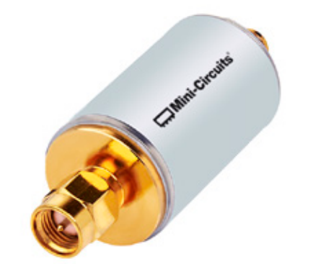
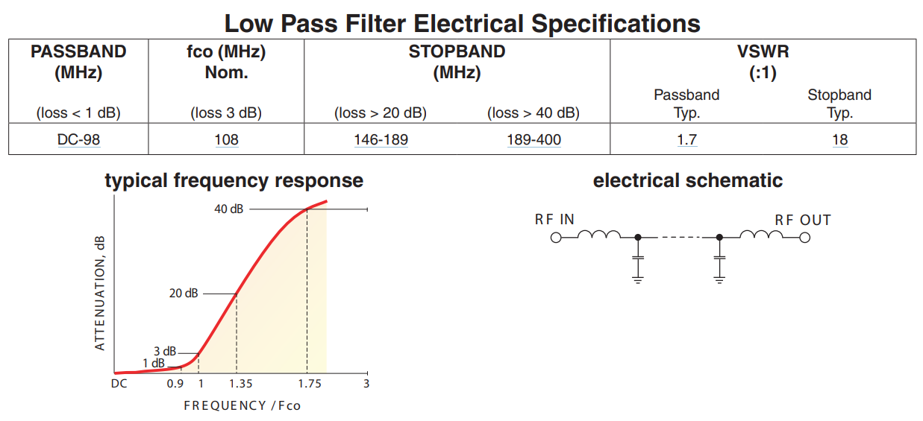
Rx IF filter
SLP100+
Pass band: DC~98MHz,
IL:0.58 @900MHz
2fo rejection : 48dB,
3fo rejection : ~75dB

Slide 14
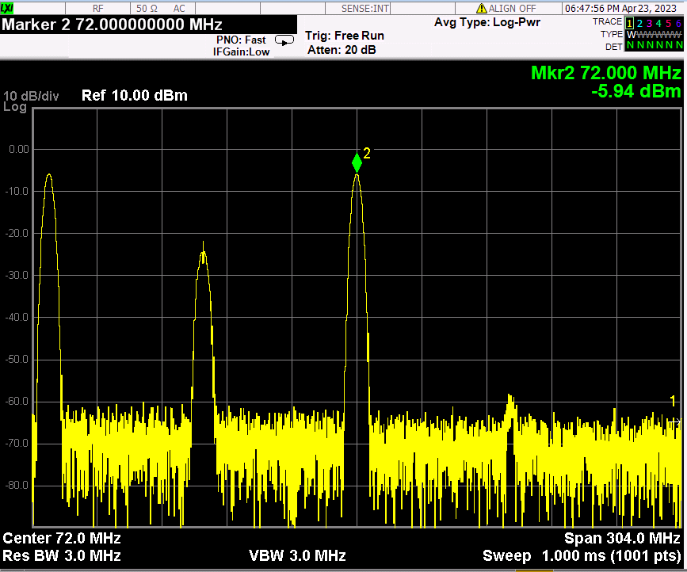
Mixer+ IF LPF(SLP100+)
morFeus B:Generator, 915MHz, morFeus A:mixer, LO:843, current:7

Slide 15
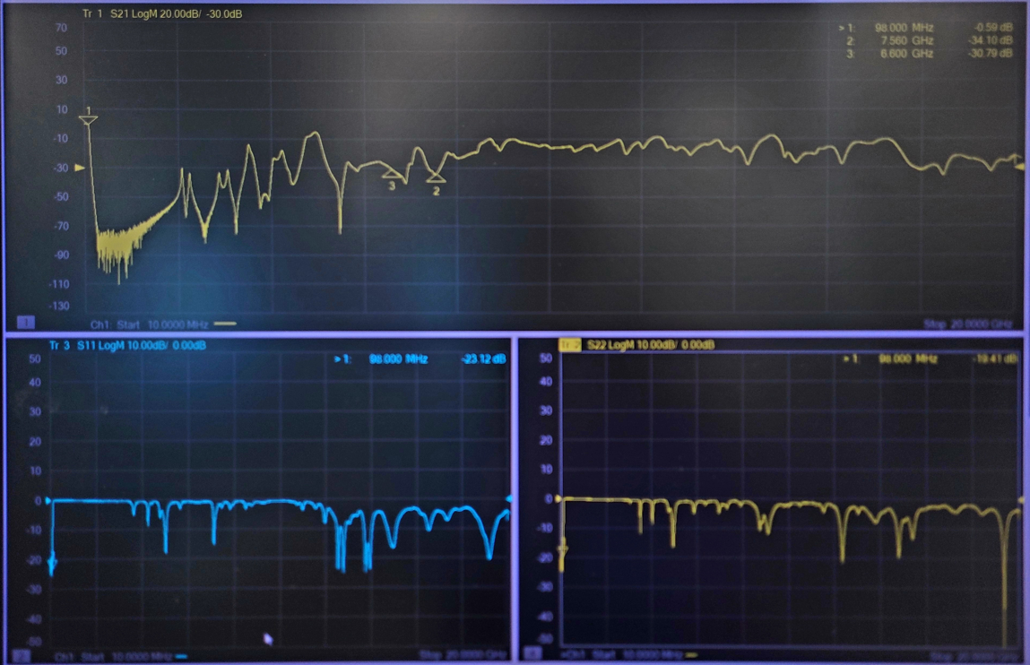
IF LPF(SLP100+) wide span

Slide 16
TX

Slide 17
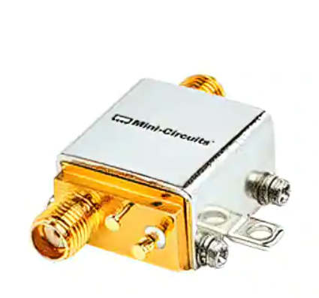
PA
ZX60-V63+
Frequency: 50MHz ~ 6GHz
P1dB : 18.5dBm
Gain : 15.4dB
Noise Figure : 4.3dB
Voltage - Supply : 4.8V ~ 5.2V
Current - Supply : 69mA
SMA Connectors

Slide 18
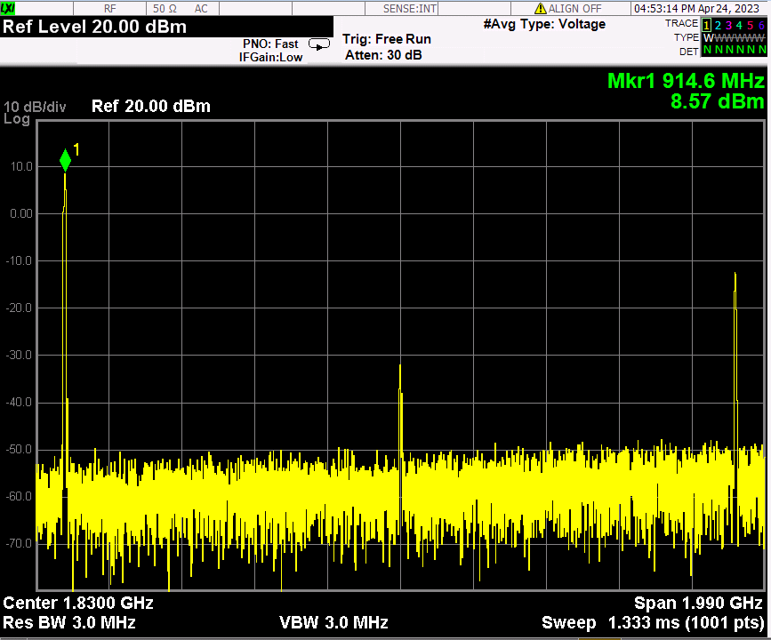
moRFeus generator(-12.12dBm)+ PA(ZX60-V63+)

Slide 19
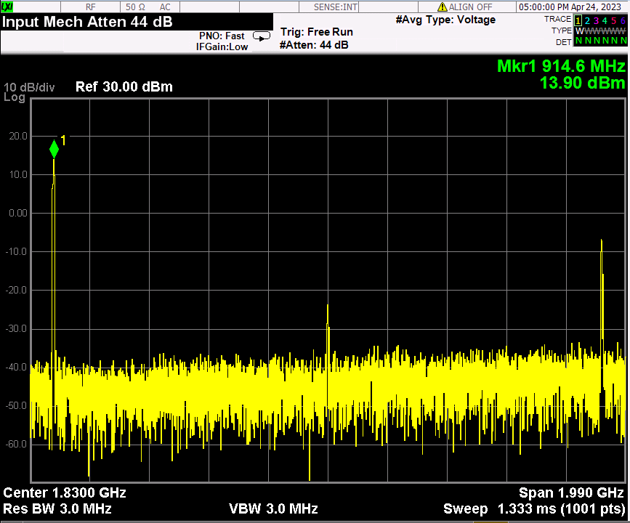
moRFeus generator(-6.65dBm)+ PA(ZX60-V63+)

Slide 20
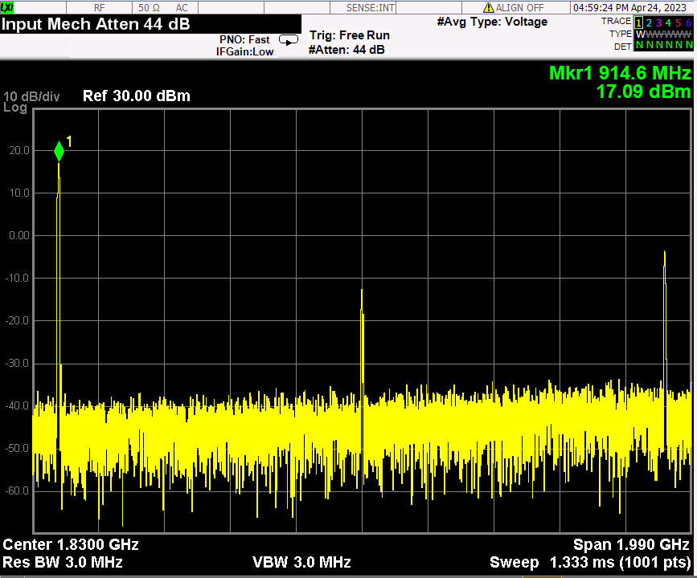
moRFeus generator(-3.35dBm)+ PA(ZX60-V63+)

Slide 21
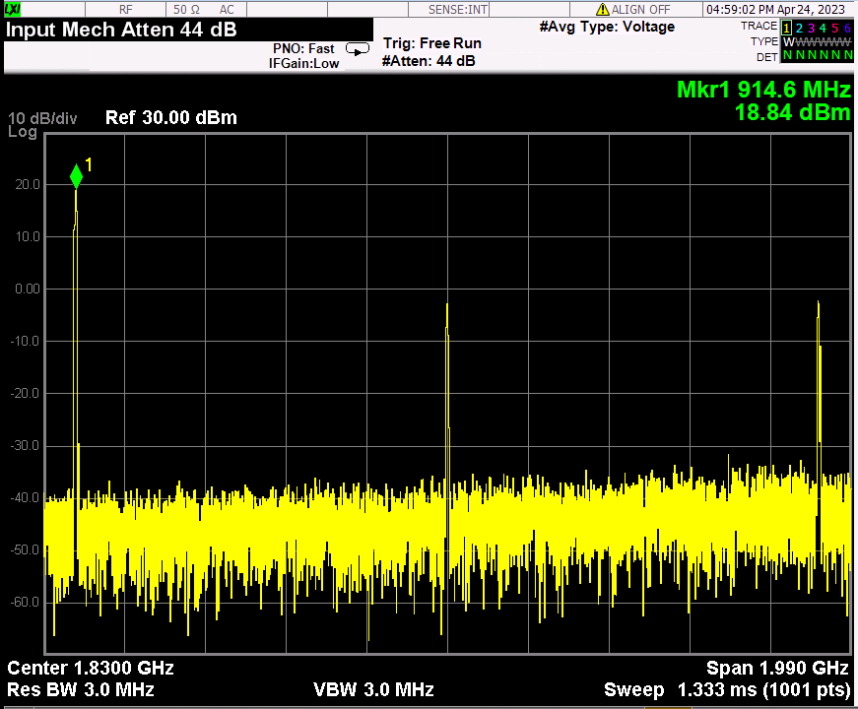
moRFeus generator(-1.30dBm)+ PA(ZX60-V63+)

Slide 22
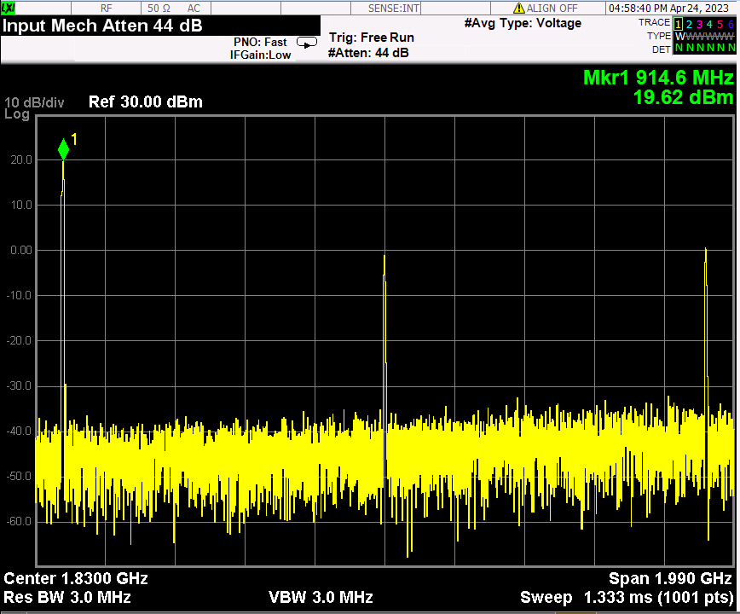
moRFeus generator(0.52dBm)+ PA(ZX60-V63+)

Slide 23
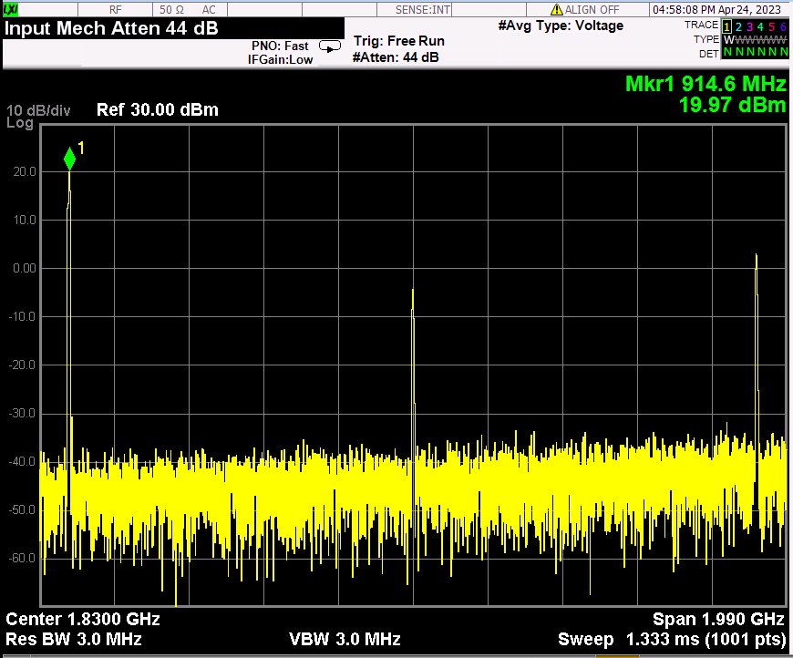
moRFeus generator(1.83dBm)+ PA(ZX60-V63+)

Slide 24
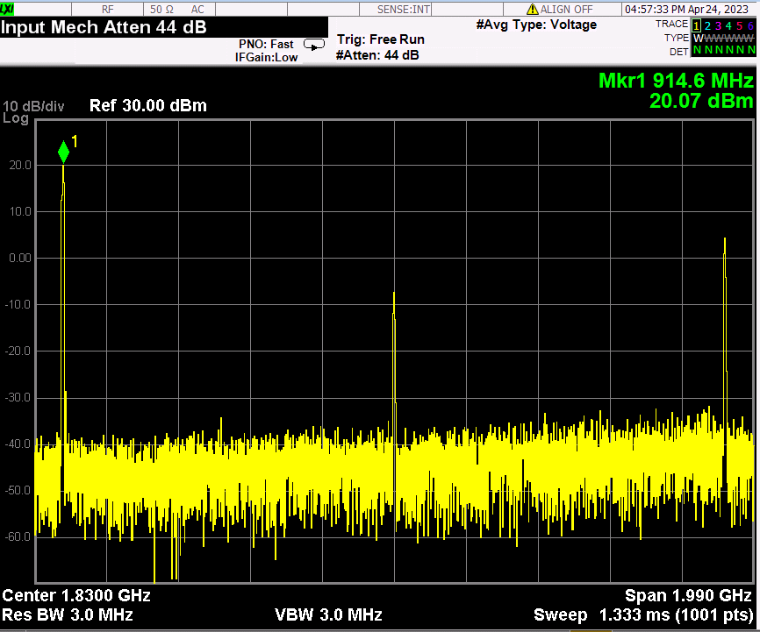
moRFeus generator(3.00dBm)+ PA(ZX60-V63+)

Slide 25
Future work
Link budget analysis : range vs. BER
RF Frontend + chanel model with Simulink for timing recovery simulation of baseband.
Rx/Tx chain integration and performance test.
Mixed signal part & FPGA interoperability test.
Troubleshooting for whole system operation.

Slide 26
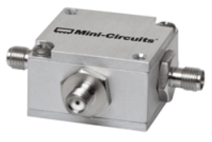
Mixer(ZFM-4H-S+): back up component
ZFM-4H-S+
low conversion loss, 4.97 dB typ.
good L-R isolation, 35 dB typ, L-I, 35 dB typ.
wideband, 5 to 1200 MHz
rugged shielded case

Slide 27
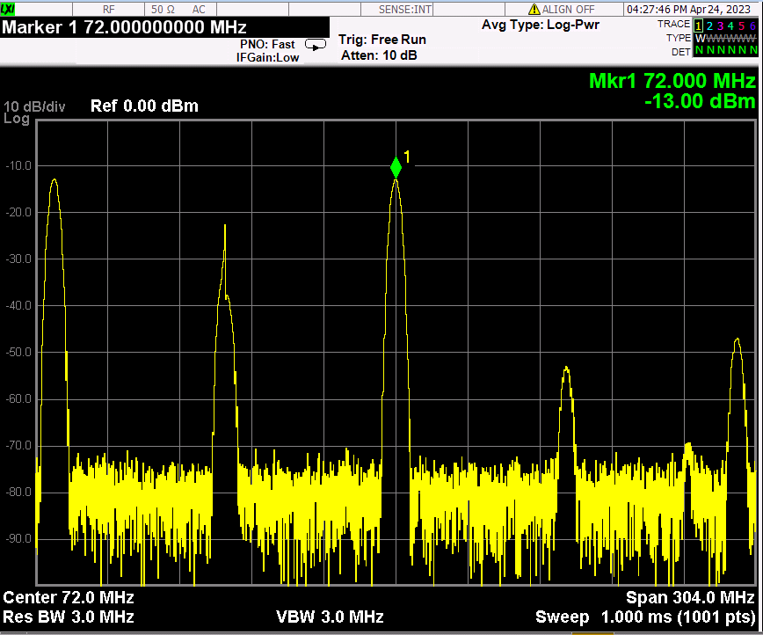
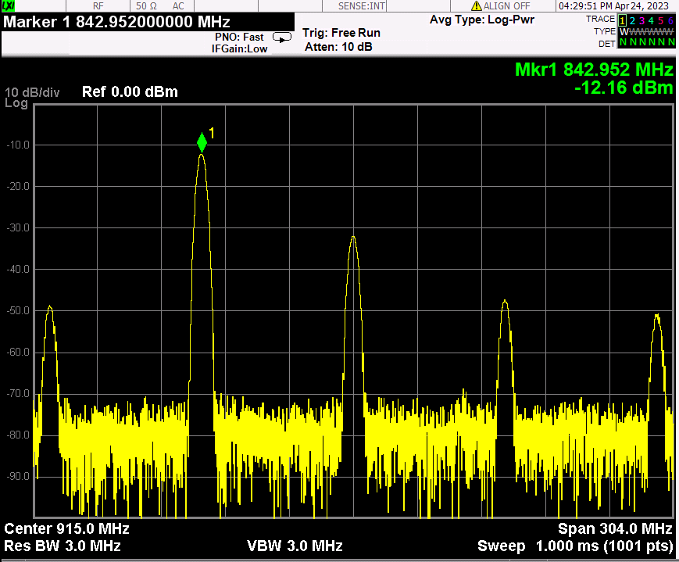
ZFM-4H-S+_I:843MHz(3dBm), L:915MHz(3dBm), R: out

Slide 28
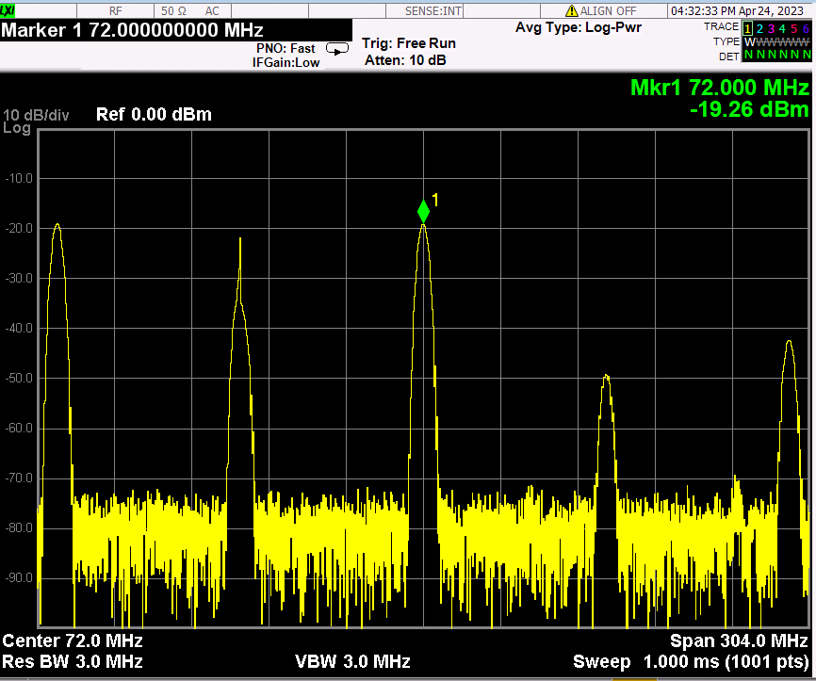
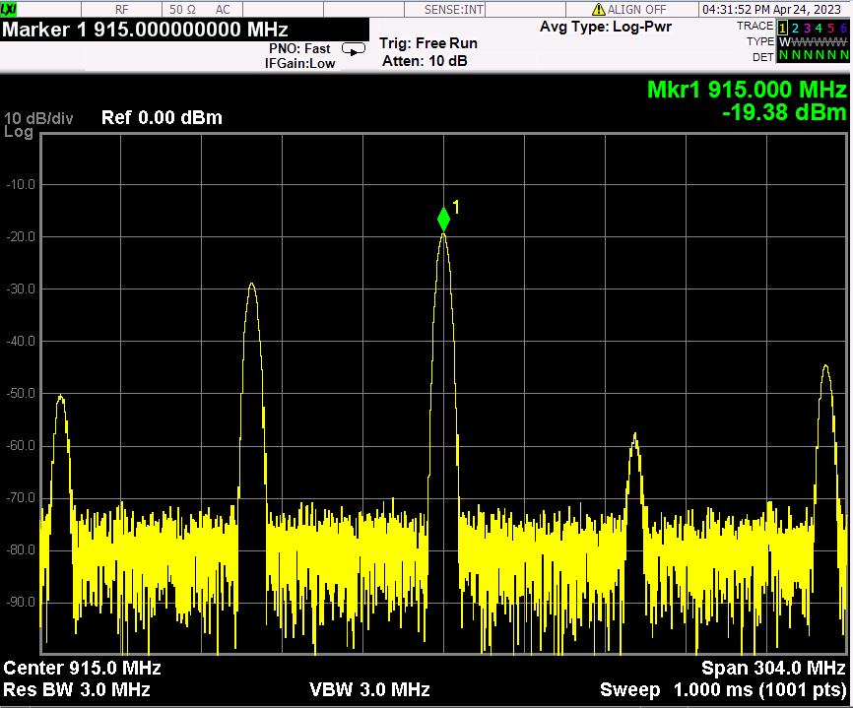
ZFM-4H-S+_I:915MHz(3dBm), L:843MHz(3dBm), R: out

Slide 29
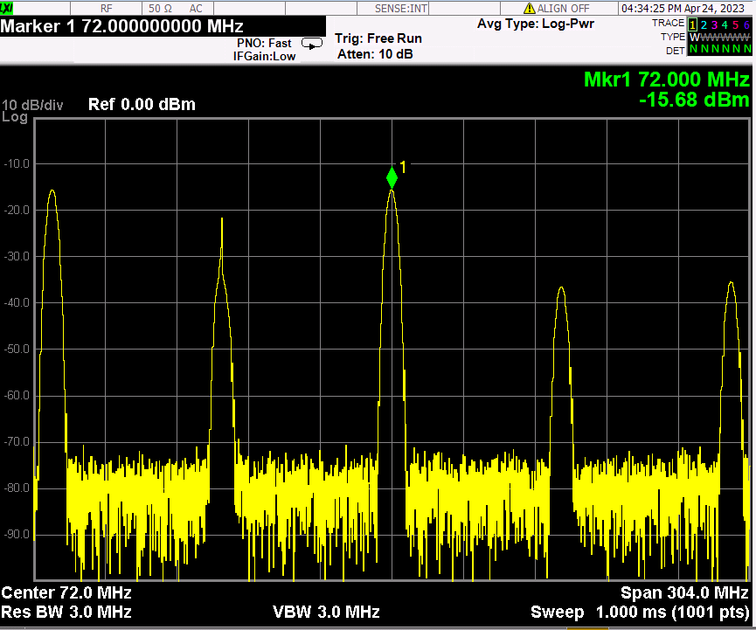
ZFM-4H-S+_I:915MHz(3dBm), L:out, R: 843MHz(3dBm)

Slide 30
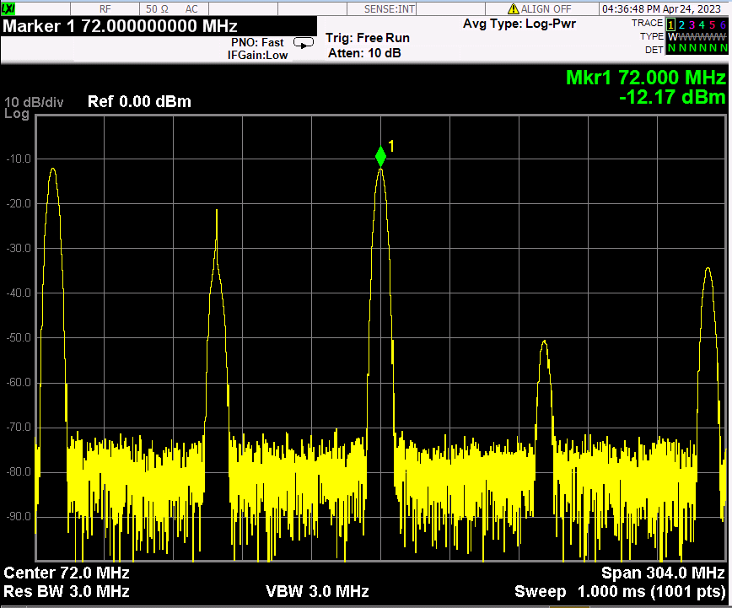
ZFM-4H-S+_I:out, L:915MHz(3dBm), R: 843MHz(3dBm)

